Slide 1
Chapter 10
Interrupt-Driven I/O
计算机系统概论
Introduction to Computing Systems
（ CS1002A.01）
苗付友
mfy@ustc.edu.cn
2025 Fall
计算机科学与技术学院
School of Computer Science and Technology

Slide 2
Outline
1
1
Review
Review
1
2
Review
Interrupt-Driven I/O

Slide 3
Review: I/O CONTROL in Von Neumann Model

Slide 4
Transfer Control
Who determines when the next data transfer occurs?
  CPU vs. I/O device
Polling is explicitly looking/examining
  CPU keeps checking status register until
  new data arrives OR device ready for next data
  “Are you there yet? Are you there yet? Are you there yet?”
Interrupts is a nudge, knock on the door, loud noise, which forces you to pay attention
  Device sends a special signal to CPU when
  new data arrives OR device ready for next data
  CPU can be performing other tasks instead of polling device.
  “Wake me when you get there.”

Slide 5
LC-3 TRAP Mechanism
Provides set of service routines
  Part of operating system -- routines start at arbitrary addresses
  Up to 256 routines
Requires table of starting addresses
  Stored in memory (x0000 through x00FF)
  Used to associate code with trap number
  Called System Control Block (or Trap Vector Table)
Uses TRAP instruction
  Used by program to transfer control to operating system (w/ privileges)
  8-bit trap vector points to one of the 256 service routines
Uses “RTI” instruction
  Returns control to caller
  Execution resumes immediately after the TRAP instruction

Slide 6
LC-3 TRAP Routines(service routines)
  GETC (TRAP x20)
    Read a single character from KBD.
    ASCII copied in R0, R0[15:8] cleared.
  OUT (TRAP x21)
    Write R0[7:0] to CRT.
  PUTS (TRAP x22)
    Write a string to CRT. String address in R0.
  IN (TRAP x23)
    Print a prompt on the screen and read a single character from KBD.
    Character is echoed to Display. ASCII copied to R0[7:0] and R0[15:8] cleared.
  HALT (TRAP x25)
    Prints message on CRT & halts execution.
x0000
预留代码空间
(实用代码空间)
:
:
:
x0020
x0400
48
x0021
x0430
32(14)
x0022
x0450
96
x0023
x04A0
64(42)
x0024
x04E0
x0025
xFD70
:
:
:
x00FF
The LC-3 System
Control Block

Slide 7
Control Instructions for System Calls
15
14
13
12
11
10
9
8
7
6
5
4
3
2
1
0
BR
0
0
0
0
n
z
p
PCoffset9
JSR
0
1
0
0
1
PCoffset11
JSRR
0
1
0
0
0
0
0
BaseR
0
0
0
0
0
0
RTI
1
0
0
0
0
0
0
0
0
0
0
0
0
0
0
0
JMP
1
1
0
0
0
0
0
BaseR
0
0
0
0
0
0
RET
1
1
0
0
0
0
0
1
1
1
0
0
0
0
0
0
TRAP
1
1
1
1
0
0
0
0
TrapVector8

Slide 8
Review: CONTROL in LC-3 Data Path
16
GatePC
16
GateMARMUX
LD.PC
PC
DR
3
MARMUX
+1
REG FILE
16
2
PCMUX
16
16
16
16
16
LD.REG
Control Unit
SR2
OUT
SR1
OUT
[7:0]
SEXT
SR2
3
SR1
+
3
ADDR2MUX
MUX
MUX
ADDR1MUX
16
16
[10:0]
16
16
16
16
16
SEXT
[8:0]
LD.CC
16
SEXT
FINITE STATE MACHINE
SR2MUX
[5:0]
SEXT
16
N
Z
P
ALUK
A
B
[4:0]
SEXT
2
ALU
LD.IR
IR
LOGIC
…
16
16
16
RUN
GateALU
16
GateMDR
16
LD.MDR
MDR
MEMORY
MAR
LD.MAR
16
INPUT
OUTPUT
MIO.EN
MUX
16
MEM.EN,R,W

Slide 9
Outline
1
1
Review
Review
1
2
Review
Interrupt-Driven I/O

Slide 10
Today: I/O in Von Neumann Model

Slide 11
Interrupt-Driven I/O
To implement an interrupt mechanism, we need:
  A way for the I/O device to signal the CPU that an interesting event has occurred.
  A way for the CPU to test whether the interrupt signal is set.
Generating Signal
  Software sets "interrupt enable(IE)" bit in device register.
  When ready bit is set and IE bit is set, interrupt is signaled.
interrupt enable bit
15
0
14
13
ready bit
KBSR
interrupt signal
to processor

Slide 12
Interrupt-Driven I/O
Testing for Interrupt Signal
  CPU looks at signal between STORE and FETCH phases
  If not set, continues with next instruction
  If set, transfers control to Interrupt Service Routine(ISR)
F
NO
D
interrupt
signal?
Transfer to
ISR
YES
EA
OP
EX
More details in Chapter 10.
S

Slide 13
Interrupt-Driven I/O
Timing of I/O controlled by device
  1. Report: Tells processor when something interesting happens
    Example: when character is entered on keyboard
    Example: when monitor is ready for next character
    Example: when block has been transferred from disk to memory
  2. Processing: Processor interrupts its normal instruction processing and executes a Interrupt Service Routine(ISR) (like a TRAP)
    1. Figure out what device is causing the interrupt
    2. Execute routine to deal with event
    3. Resume execution
No need for processor to poll device
  Can perform other useful work
Interrupt is an unscripted subroutine call, triggered by an external event

Slide 14
Interrupt-Driven I/O
Program A is executing instruction n
Program A is executing instruction n+1
Program A is executing instruction n+2
Program A is executing instruction n+3
Program A is executing instruction n+4
  ……
  ……
  ……
Program A：当前运行程序
IR:中断请求
Program B
(ISR:中断服务程序)

Slide 15
Interrupt-Driven I/O
Program A is executing instruction n
Program A is executing instruction n+1
Program A is executing instruction n+2
Interrupt!!!
Program A is executing instruction n+3
Program A is executing instruction n+4
  ……
  ……
  ……

Slide 16
Interrupt-Driven I/O
Program A is executing instruction n
Program A is executing instruction n+1
Program A is executing instruction n+2
1: Interrupt signal is detected
1: Program A is put into suspended animation
1: PC is loaded with the starting address of Program B
2: Program B starts satisying I/O device’s needs
2: Program B continues satisfying I/O device’s needs
2: Program B continues satisfying I/O device’s needs
2: Program B finishes satisfying I/O device’s needs
3: Program A is brought back to life
Program A is executing instruction n+3
Program A is executing instruction n+4
  ……
  ……
  ……

Slide 17
When to Use Interrupts
When timing of external event is uncertain
  Example: incoming packet from network
  TRAP vs. Interrupt, 12.5s vs. 0.00001s @ 100 char read from KB
When device operation takes a long time
  Example: start a disk transfer,
  disk interrupts when transfer is finished
  processor can do something else in the meantime
When event is rare but critical
  Example: building on fire -- save and shut down!

Slide 18
How is Interrupt Signaled?
External interrupt signal by Devices: INT
  Device sets INT=1 when it wants to cause an interrupt
Interrupt vector: INTV
  8-bit signal for device to identify itself
  Also used as entry of Interrupt Vector Table, which gives starting address of Interrupt Service Routine (ISR)
    Just like Trap Vector Table and Trap Service Routine
    TVT: x0000 to x00FF
    IVT: x0100 to x01FF

Slide 19
Interrupt Signal to CPU: Conditions
Several things must be true for an I/O device to actually interrupt the processor (ALL the three elements are present)
  The I/O device must want service(ready bit = 1)
  The device must have the right to request the service(interrupt enable bit = 1).
  The device request must be more urgent than what the processor is currently doing.

Slide 20
Interrupt Signal to CPU: Conditions
At the device side(I/O device set)
  Control register has “Interrupt Enable” bit
  Must be set for interrupt to be generated
At the processor(CPU set)
  Sometimes have “Interrupt Mask” register (LC-3 does not)
  When set, processor ignores INT signal
  Why? - Example: may not want to be interrupted while in ISR
CPU set: interrupt enable bit
15
0
14
13
I/O device set: ready bit
KBSR
interrupt signal
to processor(INT)

Slide 21
The State of a Program
The Processor Status Register
15
14
13
12
11
10
9
8
7
6
5
4
3
2
1
0
Pr
IE
PL
N
Z
P
PSR
Priv Mode
Priority Level
Cond Codes
PSR[15]
  0, privileged (supervisor) mode
  1, unprivileged(user)mode
The Priority Level of a program being executed
  PL[10:8]
  0(最低)~7(最高)
Orthorgnal: Privilege(特权模式)/ Priority(优先级)

Slide 22
Memory Regions for Privilege Mode
Supervisor stack
  in system space
  by operating system
  supervisor privilege required
User stack
  in user space
  by user program
  no supervisor privilege required
R6: stack pointer (SP) for the active stack
Saved_SSP / Saved_USP: save the SP not in use

Slide 23
RTI instruction
15 14 13 12
11 10 9 8 7 6
5 4 3 2 1 0
RTI
1 0 0 0
0 0 0
0 0 0
0 0 0 0 0 0
RTI – return instruction
  How to return
    if (PSR[15] == 1) % if user mode
    Initiate a privilege mode exception;
    Else % if supervisor mode, pop PC, PSR on system stack
    PC = mem[R6]; R6 is the SSP, PC is restored
    R6 = R6+1;
    TEMP = mem[R6];
    R6 = R6+1; system stack completes POP before saved PSR is restored
    PSR = TEMP; PSR is restored
    if (PSR[15] == 1) % come to user mode
    Saved SSP=R6 and R6=Saved USP;

Slide 24
Interrupt Signal to CPU
What if more than one device wants to interrupt?
  External logic controls which one gets to drive signals
14
0
13
PL1
Device
Priority encoder
PL of executing program
14
0
13
PL2
Device
B
A
INT
?
A>B
…...
14
0
13
PL7
Device

Slide 25
Testing for Interrupt Signal
CPU looks at signal between STORE and FETCH phases
If not set, continues with next instruction
If set, transfers control to interrupt service routine
F
NO
D
interrupt
signal?
Transfer to
ISR
YES
EA
OP
EX
S

Slide 26
How Does Processor Handle It?
Examines INT signal just before starting FETCH phase
  If INT=1, don’t fetch next instruction
  Instead
    Save program state (PC, PSR (privilege and CCs)) on stack
    Update PSR (clear privilege bit)
    Index INTV into IVT to get start address of ISR (put in PC)
After service routine
  RTI instruction restores PSR and PC from stack
Processor only checks between STORE and FETCH phases -- Why?

Slide 27
Supervisor Mode and the Stack
Problem
  PC and PSR shouldn’t be saved on user stack
  What if R6 is uninitialized?
  What if user has set R6 to refer to OS memory?
  User could see OS data (when trap returns)
Solution
  Create two versions of R6 (stack pointer) in register file
    One is user stack pointer (what we’ve been using all along)
    The other is supervisor stack pointer
  Extra register file logic selects the appropriate register based on privilege bit in current PSR
  Bottom line: OS code always uses its own stack

Slide 28
Example

Slide 29
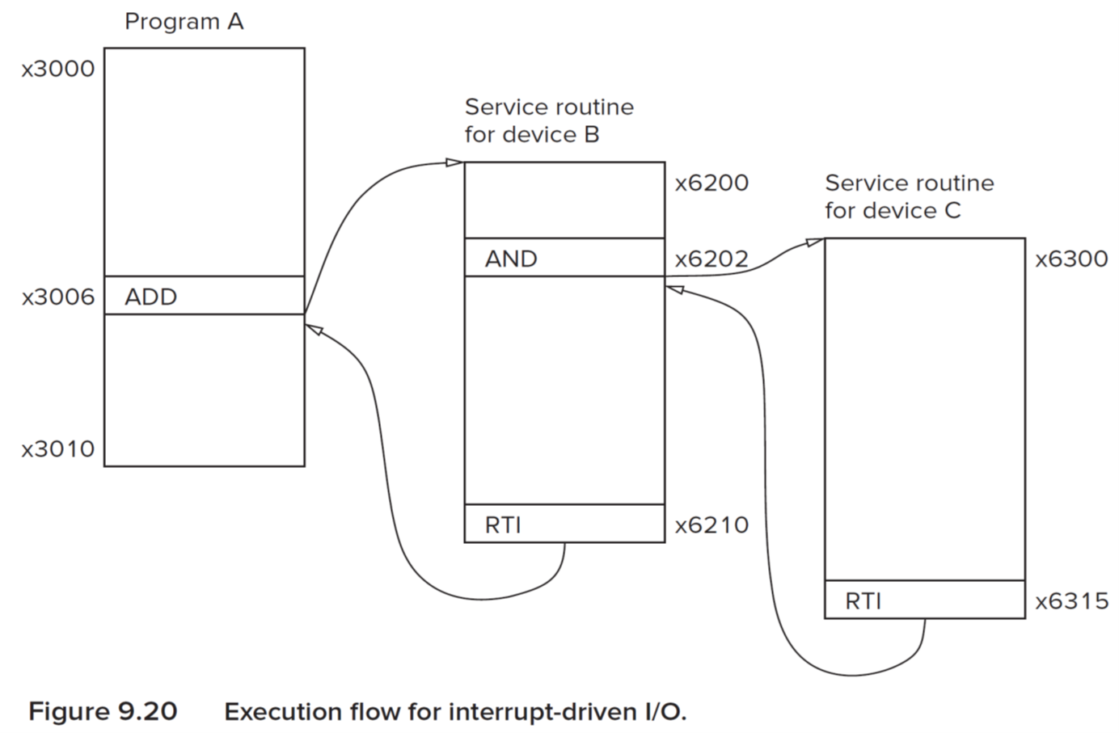
Example

Slide 30
Example
Start using the supervisor stack:
Saved_USP=R6
R6=Saved_SSP
Push PSR ;for program A
PUSH PC ;3007
ITV: xF1→x01F1;
PC=x01F1(x6200)
before program A fetches the instruction at x3007 (R6 is to user stack now!)

Slide 31
Example
When a higher priority interrupt
is detected:
PUSH PSR; for device B
PUSH PC; x6203
INTV: xF2→x01F2 (x6300)
RTI in service routine for device C:
POP PC ; X6203
POP PSR; for device B

Slide 32
Example
Resumes to x6203 and run to RTI:
POP PC; x3007
POP PSR; of program A
Saved_SSP=R6;
R6=Saved_USP.

Slide 33
When Polling Encounters Interrupt
Usually, input character is also printed to screen.
  User gets feedback on character typed
  and knows its ok to type the next character.
POLL1 LDI R0, KBSR
BRzp POLL1
LDI R0, KBDR
POLL2 LDI R1, DSR
BRzp POLL2
STI R0, DDR
...
KBSR .FILL xFE00
KBDR .FILL xFE02
DSR .FILL xFE04
DDR .FILL xFE06
new
char?
NO
YES
Keyboard
Interrupt
read
character
Display a wrong
charater
R0← new character
screen
ready?
NO
YES
write
character
2025/12/9
33

Slide 34
Solution
01 .ORIG x0420
02 ADD R6,R6,#-1
03 STR R1,R6,#0
04 ADD R6,R6,#-1
05 STR R2,R6,#0
06 ADD R6,R6,#-1
07 STR R3,R6,#0 ; Save R1,R2,R3 on the stack
08
09 LDI R1, PSR
0A LD R2,INTMASK
0B AND R2,R1,R2 ; R1=original PSR, R2=PSR with interrupts disabled
0C
0D POLL STI R1,PSR ; enable interrupts (if they were enabled to begin)
0E STI R2,PSR ; disable interrupts
0F LDI R3,DSR
10 BRzp POLL ; Poll the DSR
11 STI R0,DDR ; Store the character into the DDR
12 STI R1,PSR ; Restore original PSR
13
14 LDR R3,R6,#0
15 ADD R6,R6,#1
16 LDR R2,R6,#0
17 ADD R6,R6,#1
18 LDR R1,R6,#0
19 ADD R6,R6,#1
; Restore R3,R2,and R1 from the stack
1A
1B RTI
1C
1D INTMASK .FILL xBFFF
1E PSR .FILL xFFFC
1F DSR .FILL xFE04
20 DDR .FILL xFE06
21
22 .END
确保屏幕输出为用户最后输入的字符
PSR[14] is the interrupt enable bit for
all interrupts associated with this program

